Slide 1


Strings and Operators
CSC 101 Practical · Week 6
2026/2027 Session
Pan-Atlantic University

Slide 2
Today's Practical
Part 1
Strings
Literals vs String objects, the methods toolbox, and format!. Practices 1 to 7.
Part 2
Operators
Arithmetic, relational, logical and bitwise. Practices 8 to 11.
Project
The restaurant menu
A real order-taking program: menu, quantities, totals and a discount rule.

Slide 3


PART 1 OF 2
Strings
Two kinds of text, a toolbox of methods, and the format! macro.

Slide 4
Two Kinds of Strings
String literal
&str
The value is known at compile time, hardcoded into the variable.
Lives in the module std::str. Also called a string slice.
Static by default: guaranteed valid for the whole program.
String object
String
Comes from the Standard Library, not the core language.
A growable collection: mutable and UTF-8 encoded.
Holds values provided at runtime. Allocated in the heap.

Slide 5
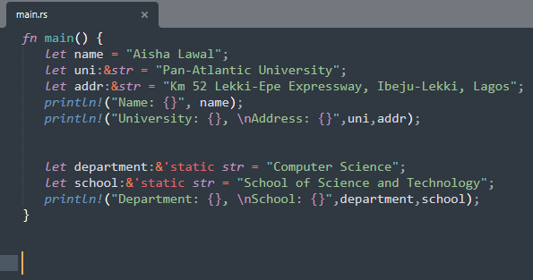
Practice 1: String Literals
Five literals: a name, the university, its address, a department and a school.
1
Hardcoded at compile time
let name = "Aisha Lawal";
2
The type behind it is &str
let uni: &str = "Pan-Atlantic University";
3
'static spells the guarantee out
let department: &'static str = ...
The text lives for the entire run of the program.

Slide 6
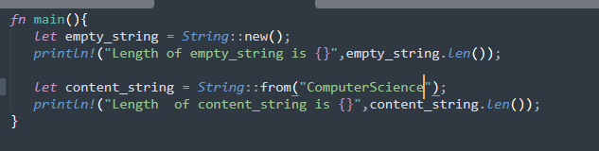
Practice 2: Creating a String Object
Two ways to make a String object: new() gives you an empty one, from() fills it on arrival.
1
Empty to start
String::new()
Length 0.
2
Or born with content
String::from("ComputerScience")
Length 15.
3
len() counts bytes
.len()

Slide 7
The String Toolbox · 1 of 2
Eleven methods you will use all semester. The first six:
new()
Creates a new empty String.
to_string()
Converts a value into a String.
replace()
Swaps every match of a pattern for another string.
as_str()
Borrows the whole String as a string slice.
push()
Appends a single character to the end.
push_str()
Appends a string slice to the end.

Slide 8
The String Toolbox · 2 of 2
And the other five:
len()
The length of the String, counted in bytes.
trim()
Strips whitespace from both ends.
split_whitespace()
Splits on whitespace and returns an iterator.
split()
Splits wherever a pattern matches: a &str, a char or a closure.
chars()
Iterates over the characters one by one.

Slide 9
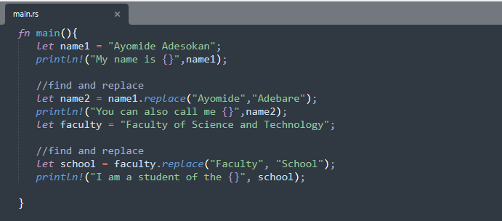
Practice 3: replace()
One method, two jobs: renaming a person and renaming a faculty.
1
Find this, put that
name1.replace("Ayomide", "Adebare")
2
Every match is swapped
faculty.replace("Faculty", "School")
3
The original survives
replace() returns a new String; name1 is untouched.

Slide 10
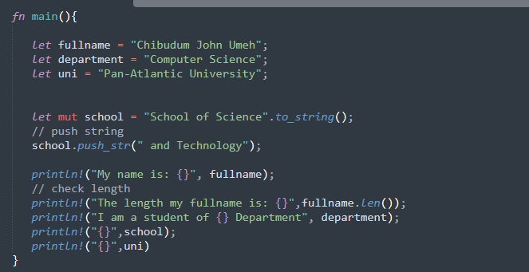
Practice 4: push_str()
Growing a String in place: School of Science becomes School of Science and Technology.
1
Append to the end
school.push_str(" and Technology")
2
Only mut Strings can grow
let mut school = ...
3
Measure the result
fullname.len()
Bytes, spaces included.

Slide 11
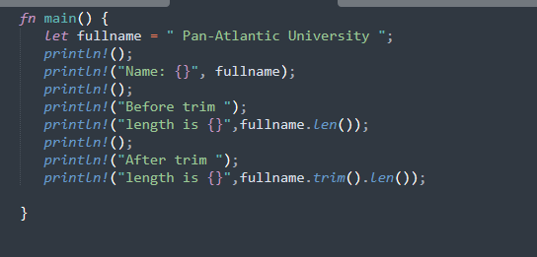
Practice 5: trim()
The method you have quietly used since Week 4, finally explained.
1
Spaces hide at both ends
" Pan-Atlantic University "
2
trim() cleans the edges
fullname.trim().len()
3
Inside spaces survive
Only leading and trailing whitespace is removed.

Slide 12
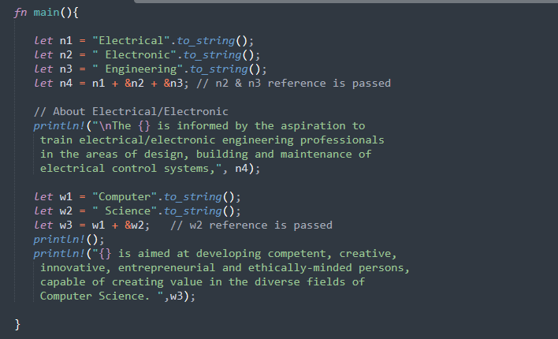
Practice 6: Concatenation
Joining Strings with the + operator, and a first taste of references.
1
+ joins Strings
let n4 = n1 + &n2 + &n3;
2
Mind the &
After the first String, the others are passed by reference.
3
n1 moves into the result
It cannot be used on its own afterwards. Ownership week explains why.

Slide 13
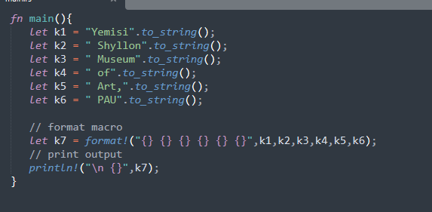
Practice 7: The format! Macro
Like println!, but the result lands in a variable. Watch what the six pieces spell.
1
Six Strings in
format!("{} {} {} {} {} {}", k1, ..., k6)
2
One String out
format! builds a String instead of printing it.
3
Print it whenever you like
println!("\n {}", k7);

Slide 14
PART 2 OF 2
Operators
The symbols that do the work: arithmetic, relational, logical and bitwise.

Slide 15
What is an Operator?
An operator is a function performed on data. The data it works on are called operands.
7 + 5 = 12 7, 5 and 12 are operands. + and = are operators.
Arithmetic
Relational
Logical
Bitwise
Conditional
The first four are today's work. Conditional operators wait for a later week.

Slide 16
Arithmetic Operators
With a = 10 and b = 5:
Operator
What it does
Example
+
Adds the operands
a + b is 15
-
Subtracts the second from the first
a - b is 5
*
Multiplies the operands
a * b is 50
/
Divides and keeps the quotient
a / b is 2
%
Divides and keeps the remainder
a % b is 0

Slide 17
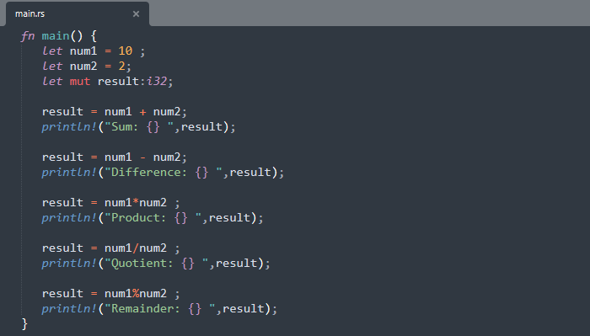
Practice 8: Arithmetic
All five arithmetic operators over the same two numbers.
1
Five operators, one pattern
result = num1 % num2;
2
With 10 and 2
Sum 12, difference 8, product 20, quotient 5, remainder 0.
3
Remainder is the quiet star
You used it in Week 4's Practice 9 without naming it.

Slide 18
Relational Operators
They compare two values and answer with a bool. With A = 10 and B = 20:
Operator
What it does
Example
>
Greater than
A > B is false
<
Less than
A < B is true
>=
Greater than or equal to
A >= B is false
<=
Less than or equal to
A <= B is true
==
Equal to
A == B is false
!=
Not equal to
A != B is true

Slide 19
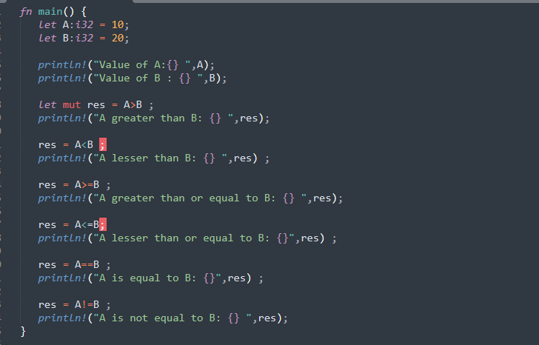
Practice 9: Relational
Every relational operator, applied to A = 10 and B = 20.
1
Comparisons return bool
let res = A > B;
2
Print them straight
false, true, false, true, false, true, down the list.
3
Two easy to confuse
== asks are they equal. != asks are they different.

Slide 20
Logical Operators
They combine conditions. With A = 10 and B = 20:
Operator
What it does
Example
&&
True only when every expression is true
A > 10 && B > 10 is false
||
True when at least one expression is true
A > 10 || B > 10 is true
!
Inverts the result
!(A > 10) is true

Slide 21
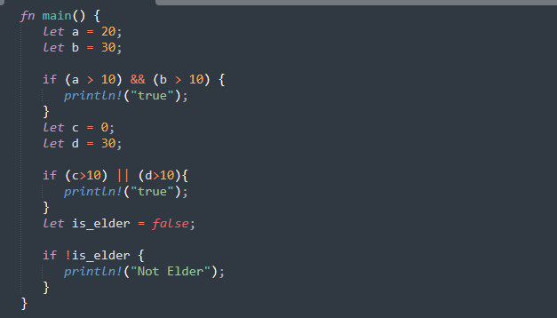
Practice 10: Logical
The Week 4 ladder used && already. Here is the full family.
1
&& needs both
(a > 10) && (b > 10)
2
|| needs just one
(c > 10) || (d > 10)
3
! flips a bool
if !is_elder
is_elder is false, so !is_elder is true: Not Elder prints.

Slide 22
Bitwise Operators
They work on integers one bit at a time. With A = 2 (binary 10) and B = 3 (binary 11):
Operator
What it does
Example
&
AND on each pair of bits
A & B is 2
|
OR on each pair of bits
A | B is 3
^
XOR: one or the other, not both
A ^ B is 1
!
Flips every bit
!B is -4
<<
Shifts bits left; each place doubles the value
A << 1 is 4
>>
Shifts bits right; each place halves it
A >> 1 is 1

Slide 23
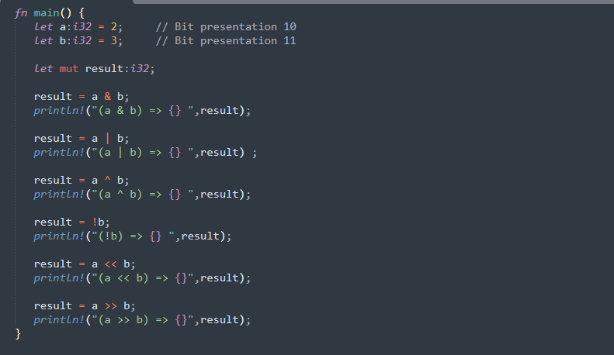
Practice 11: Bitwise
The same two small numbers, worked on bit by bit.
1
Think in binary
2 is 10, 3 is 11. Line the bits up and apply the rule.
2
The pair-wise three
a & b, a | b, a ^ b
3
Shifts are arithmetic in disguise
a << b, a >> b
Left doubles per place, right halves.

Slide 24
CLASS PROJECT
The Restaurant Menu
Everything from today plus Week 4, in one order-taking program.

Slide 25
Project: The Restaurant Menu
Write a Rust program that displays this menu, then reads the food type and quantity from the customer. It computes the total charge, and if the total is greater than N10,000 it gives a 5% discount.
P
Poundo Yam / Edinkaiko Soup
N3,200
F
Fried Rice & Chicken
N3,000
A
Amala & Ewedu Soup
N2,500
E
Eba & Egusi Soup
N2,000
W
White Rice & Stew
N2,500
You will need: input reading, a decision on the letter, arithmetic for the total, and one last if for the discount.

Slide 26


Questions?
Homework: The menu project, pushed to week-6.
www.pau.edu.ng
pau_Nigeria
Pan-Atlantic University

